Slide 1

Data Preprocessing

Slide 2

Why Preprocess the Data?
Low‐quality data Low‐quality mining results
Huge size of real‐world databases
highly susceptible to noisy, missing, and inconsistent data
origin from multiple, heterogenous sources
Major issues with Data Quality
Accuracy: correct or wrong, accurate or not, noisy, …
Completeness: not recorded, unavailable, …
Consistency: some modified but some not, dangling, …
Timeliness: timely update?
Believability: how trustable the data are correct?
Interpretability: how easily the data can be understood?

Slide 3
Major Tasks in Data Preprocessing
Data cleaning
Fill in missing values, smooth noisy data, identify or remove outliers, and resolve inconsistencies
Data integration
Integration of multiple databases, data cubes, or files
Data reduction
Dimensionality reduction
Numerosity reduction
Data transformation and data discretization
Normalization
Concept hierarchy generation

Slide 4
Data Cleaning
Data in the Real World is Dirty: Lots of potentially incorrect data, e.g., instrument faulty, human or computer error, transmission error
incomplete: lacking attribute values, lacking certain attributes of interest, or containing only aggregate data
e.g., Occupation = “ ” (missing data)
noisy: containing noise, errors, or outliers
e.g., Salary = “−10” (an error)
inconsistent: containing discrepancies in codes or names, e.g.,
Age = “42”, Birthday = “03/07/2010”
Was rating “1, 2, 3”, now rating “A, B, C”
intentional: (e.g., disguised missing data)
Jan. 1 as everyone’s birthday?

Slide 5
How to Handle Missing Data?
Ignore the tuple: usually done when class label is missing (when doing classification)
Fill in the missing value manually: tedious + infeasible
Fill in it automatically with
a global constant : e.g., “unknown”, a new class?!
the attribute mean / median
the attribute mean for all samples belonging to the same class
the most probable value: regression, inference‐based such as Bayesian formula or decision tree

Slide 6



How to Handle Noisy Data?
Noise: random error or variance in a measured variable
“Smooth” out the data to remove the noise
Binning
first sort data and partition into (equal‐frequency) bins
then one can smooth by bin means, smooth by bin median, smooth by bin boundaries, etc.

Slide 7
How to Handle Noisy Data?
Regression
smooth by fitting the data into regression functions
Clustering
detect and remove outliers
Combined computer and human inspection
detect suspicious values

Slide 8
Data Integration
Data integration
Combines data from multiple sources into a coherent store (data warehouse)
Schema integration: e.g., A.cust‐id ≡ B.cust‐#
Integrate metadata from different sources
Entity identification problem:
How can equivalent real‐world entities from multiple data sources be matched up?
Detecting and resolving data value conflicts
For the same real world entity, attribute values from different sources are different
Possible reasons: different representations, different scales, e.g., metric vs. British units

Slide 9
Handling Redundancy in Data Integration
Redundant data occurs often when integration of multiple databases
Object identification: The same attribute or object may have different names in different databases
Derivable data: One attribute may be a “derived” attribute in another table, e.g., annual revenue
Redundant attributes can be detected by correlation and
covariance analysis
Careful integration of the data from multiple sources may help reduce/avoid redundancies and inconsistencies and improve mining speed and quality

Slide 10
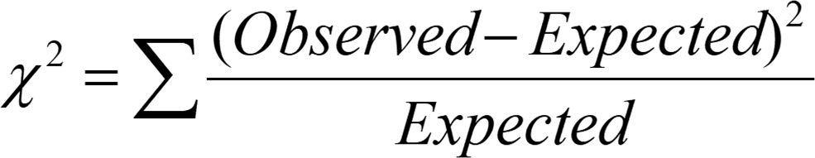
Correlation Analysis (Nominal Data)
Χ² (chi‐square) test
The larger the Χ² value, the more likely the variables are related
Correlation does not imply causality
# of hospitals and # of car‐theft in a city are correlated
Both are causally linked to the third variable: population

Slide 11
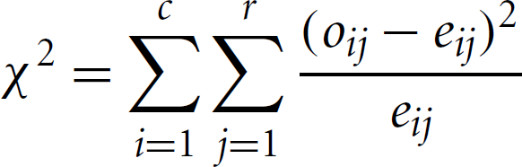
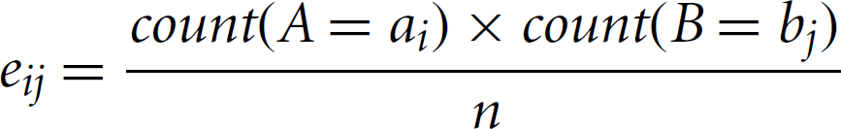
Correlation Analysis (Nominal Data)
Correlation relationship between two attributes, A and B
A has c distinct values and B has r
Contingency table: c values of A are the columns and r values of B
the rows
(A_{i} ,B_{j}): joint event that attribute A takes on value a_{i} and attribute B
takes on value b_{j}
o_{ij} = observed frequency, e_{ij} = expected frequency
Test is based on a significance level, with (r ‐1)x(c‐1) degrees of freedom

Slide 12
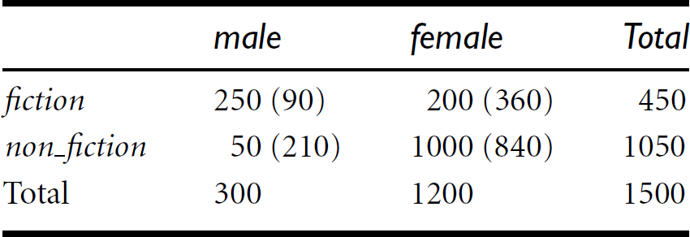

Example
A group of 1500 people was surveyed
Gender of each person was noted
Preferred type of reading: fiction or non‐fiction
For 1 degree of freedom, the value needed to reject the hypothesis at the
0.001 significance level is 10.828
The two attributes are (strongly) correlated for the given group of people

Slide 13
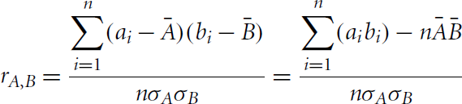
Correlation Analysis (Numeric Data)
Correlation coefficient (also called Pearson’s product moment coefficient)
where n is the number of tuples, A and B are the respective means of A and B, σ_{A} and σ_{B} are the respective standard deviation of A and B, and Σ(a_{i}b_{i}) is the sum of the AB cross‐ product
‐1 <= r_{A,B} <= +1
If r_{A,B} > 0, A and B are positively correlated (A’s values increase as B’s). The higher, the stronger correlation
r_{A,B} = 0: independent; r_{AB} < 0: negatively correlated

Slide 14
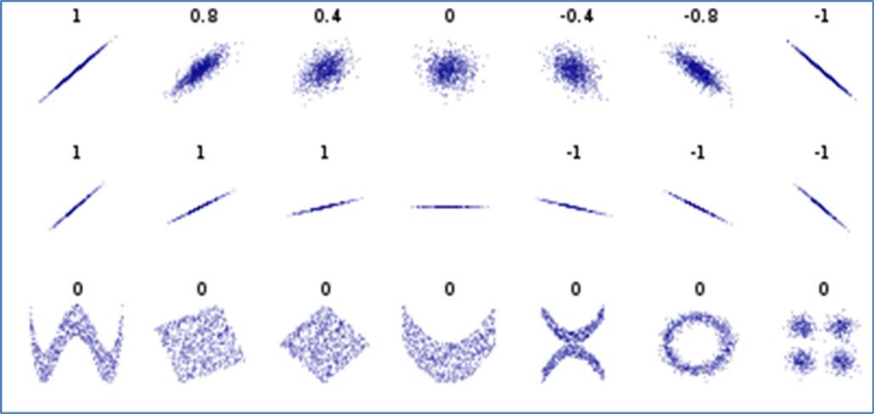
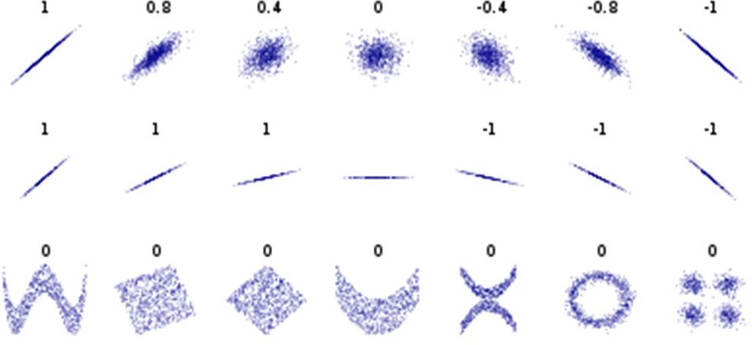
Correlation Analysis
Correlation reflects the noisiness and direction of a linear relationship (top row), but not the slope of that relationship (middle), nor many aspects of nonlinear relationships (bottom)
Figure in the center has a slope of 0 but in that case the correlation coefficient is undefined because the variance of Y is zero
Score will just be 0 (for example, for a sinus wave, a quadratic curve or a mysterious step function), saying: “Nothing interesting here”
Correlation is symmetric
correlation of A and B = correlation of B and A
Relationships in the real world are rarely symmetric
relationship between zip code and city
A column with 3 unique values will never be able to perfectly predict another column with 100 unique values. But the opposite might be true

Slide 15
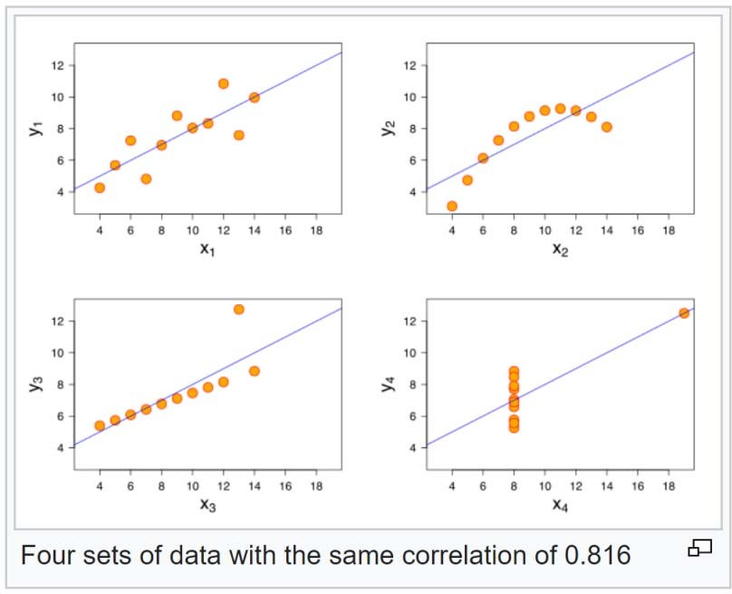
Correlation Analysis
Scatter plots of set of four different pairs of variables created by Francis Anscombe
The four y variables have the same mean (7.5), variance (4.12), correlation (0.816) and regression line (y = 3 + 0.5x)
However, distribution of the variables is very different
first one (top left) seems to be distributed normally
second one (top right) is not distributed normally
Anscombe, Francis J. (1973). "Graphs in statistical analysis".
The American Statistician. 27 (1): 17–21.

Slide 16
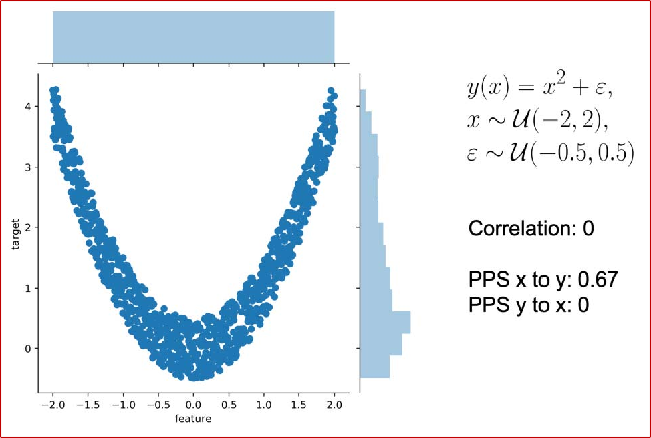
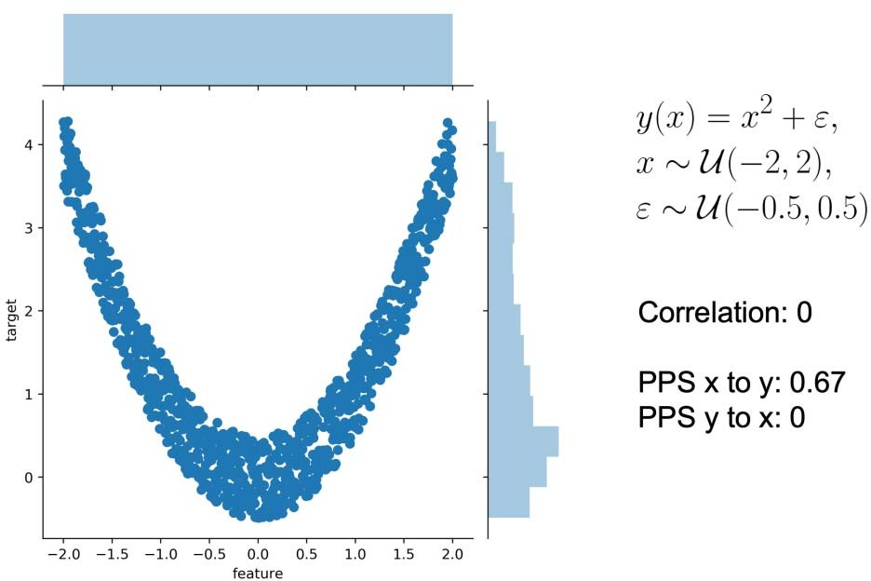
Predictive Power Score
An asymmetric, data‐type‐agnostic score that can detect linear or non‐ linear relationships between two columns
Score ranges from 0 (no predictive power) to 1 (perfect predictive power)
Score can handle categoric and numeric columns
There is not the one and only way to calculate the predictive power score
Score is calculated using only 1 feature trying to predict the target column
Non‐linear effects and asymmetry
Correlation is 0. Both from x to y and from y to x because the correlation is symmetric
PPS from x to y is 0.67, detecting the non‐linear relationship
PPS is not 1 because there exists some error in the relationship
PPS from y to x is 0 because prediction cannot be better than the naive baseline and thus the score is 0

Slide 17
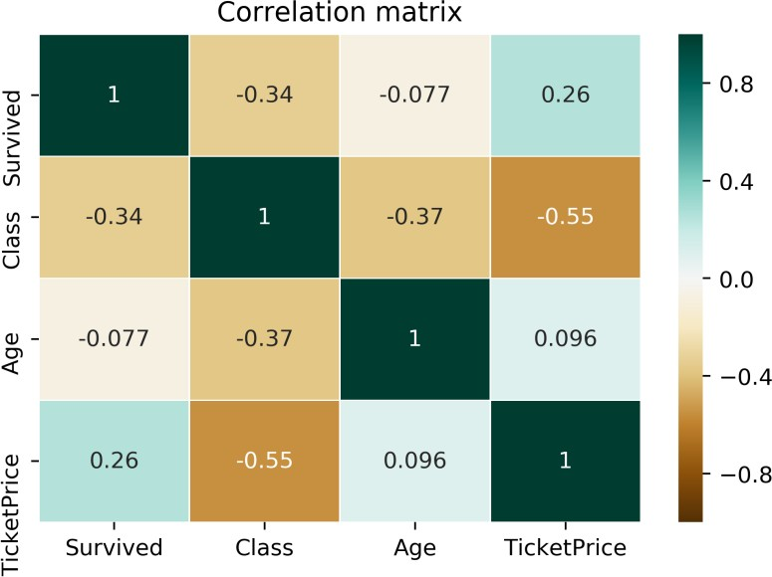
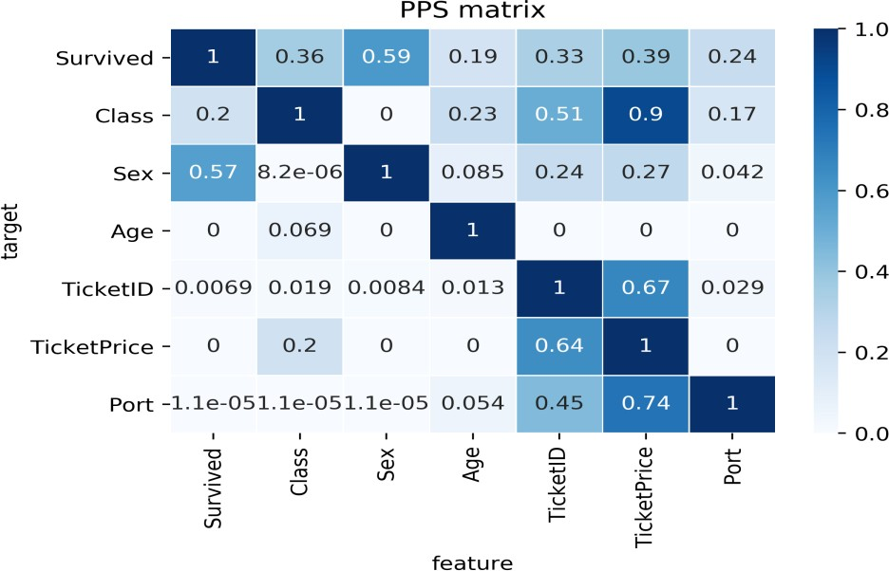
Predictive Power Score
Categorical columns and hidden patterns
Correlation matrix vs. PPS matrix
– Titanic dataset (https://www.kaggle.com/c/titanic)
Correlation matrix is smaller and leaves out many interesting relationships
Columns like Sex, TicketID or Port are categoric and the correlation cannot be computed for them
A negative correlation between TicketPrice and Class of medium strength (‐0.55)
TicketPrice is a strong predictor for the Class (0.9 PPS) but not vice versa. The Class only predicts the TicketPrice with a PPS of 0.2
Let say, ticket price for highest class ranges from $5000 to
$10,000
Therefore, whether the ticket costs 5000$ or 10,000$, the passenger was most likely from the highest class
In contrast, if we know that someone was in the highest class you cannot say whether they paid $5000 or $10,000 for their ticket

Slide 18
Calculating Predictive Power Score
Many possible ways to calculate PPS
If you want to calculate the predictive power score of A predicting B
treat B as the target variable and A as the (only) feature
calculate a cross‐validated Decision tree
calculate a suitable evaluation metric
when the target is numeric, use a Decision Tree Regressor and calculate the Mean Absolute Error(MAE)
when the target is categoric, use a Decision Tree Classifier and calculate the weighted F1
other scores like the ROC can be also used

Slide 19
Predictive Power Score
Limitations
Calculation is slower than the correlation
Score cannot be interpreted as easily as the correlation because it does not tell anything about the type of relationship
Cannot compare the scores for different target variables in a strict mathematical way because they are calculated using different evaluation metrics
PPS cannot detect interaction effects between features towards the target

Slide 20
Data Reduction Strategies
Objective: Obtain a reduced representation of the data set that is much smaller in volume but yet produces the same (or almost the same) analytical results
Why? — Complex data analysis may take a very long time to run on the complete data set
Data reduction strategies
Dimensionality reduction
Wavelet transforms
Principal Components Analysis (PCA)
Attribute/Feature subset selection, feature creation
Numerosity reduction
Regression and Log‐Linear Models
Histograms, clustering, sampling
Data cube aggregation
Data compression

Slide 21
Principal Components Analysis
Original data has n attributes or dimensions
PCA searches for k n‐dimensional orthogonal vectors that can best be used to represent the data, where k ≤ n
Original data thus projected onto a much smaller space
“Combines” the essence of attributes; attributes with similar patterns across all records
variables “intention to purchase a product” and “degree of liking for the product”
Often reveals relationships that were not previously suspected
New variables are called principal components (PC) or factors
PCs are extracted sequentially
First PC, PC(1), accounts for the most variance in the data
PC(1) is a vector that points in the direction in which the data are most “spread out”

Slide 22
Principal Components Analysis
To reduce dimensionality use far fewer components for interpretation than original variables
Number of PCs to retain: trade‐off between interpretability and information loss
Component loading – correlation between original variables and PCs
Steps:
Input data are normalized, so that each attribute falls within the same range
PCA computes k orthonormal unit vectors that provide a basis for the normalized input data. Input data are a linear combination of the principal components
Principal components are sorted in order of decreasing “significance” or strength
Using the strongest principal components, possible to reconstruct a good approximation of the original data
https://towardsdatascience.com/a‐one‐stop‐shop‐for‐principal‐component‐analysis‐5582fb7e0a9c

Slide 23
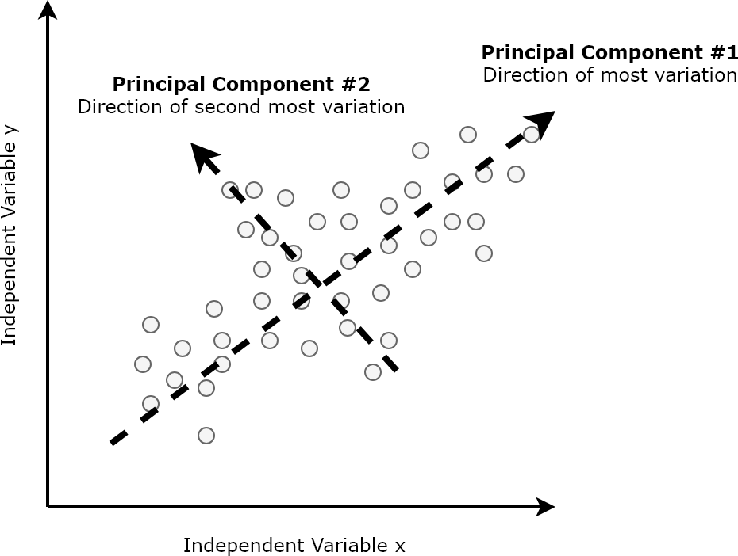
Principal Components Analysis

Slide 24
Attribute Subset Selection
Irrelevant, weakly relevant, or redundant attributes or dimensions are detected and removed
Redundant attributes
E.g., purchase price of a product and the amount of sales tax paid
Irrelevant attributes
Contain no information that is useful for the data mining task at hand
E.g., students' ID is often irrelevant to the task of predicting students' GPA

Slide 25
Heuristic Search in Attribute Selection
There are 2^{n} possible attribute combinations of n
attributes
An exhaustive search for the optimal subset of attributes can be prohibitively expensive
Typical heuristic attribute selection methods:
Stepwise forward selection
Stepwise backward elimination
Combination of forward selection and backward elimination
Decision tree induction

Slide 26
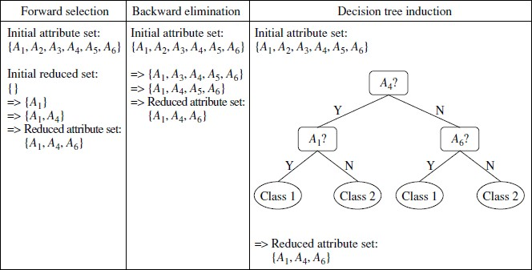
Heuristic Search in Attribute Selection

Slide 27
Attribute Creation (Feature Generation)
Create new attributes (features) that can capture the important information in a data set more effectively than the original ones
– E.g., attribute area based on attributes length and width
Attribute construction can discover missing information about the relationships between attributes that can be useful for KD

Slide 28
Data Reduction 2: Numerosity Reduction
Reduce data volume by choosing alternative, smaller forms of data representation
Parametric methods
Assume the data fits some model, estimate model parameters, store only the parameters, and discard the data (except possible outliers)
E.g.: regression
Non‐parametric methods
Do not assume models
Major families: histograms, clustering, sampling, data cube, …

Slide 29
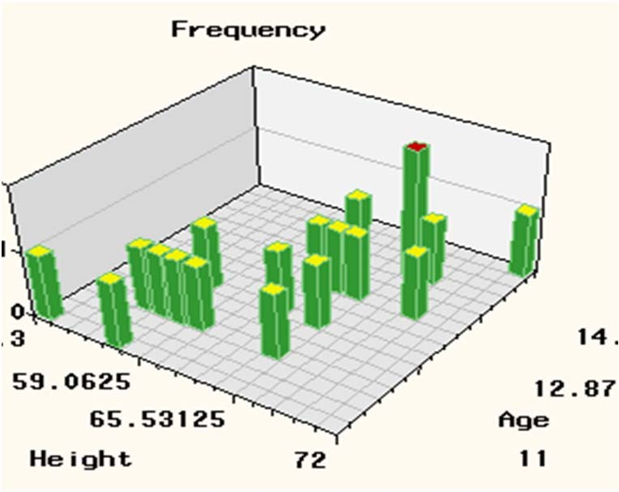
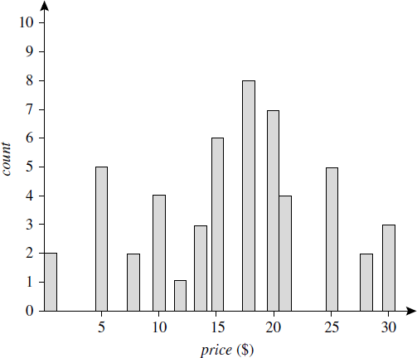
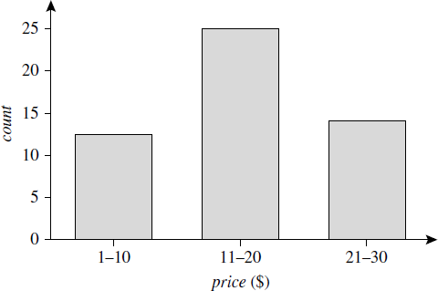
Non‐Parametric Methods
Histogram
Singleton bucket
Equal width
Equal frequency
Multidimensional
A histogram for price using singleton buckets—each bucket represents one price‐frequency pair
An equal‐width histogram for price, where values are aggregated so that each bucket has a uniform width of $10

Slide 30
Non‐Parametric Methods
Sampling
Simple random sample without replacement (SRSWOR)
drawing s of the N tuples from D (s < N)
probability of drawing any tuple in D is 1/N
Simple random sample with replacement (SRSWR)
similar to SRSWOR except that after a tuple is drawn, it is placed back in D so that it may be drawn again
Cluster sample
tuples in D are grouped into M mutually disjoint “clusters”
a simple random sample of s (s < M) clusters are obtained
Stratified sample
D is divided into mutually disjoint parts called strata
obtain a simple random sample at each stratum
ensures a representative sample, especially when the data are skewed
Advantage
cost of obtaining a sample is proportional to the size of the sample, s, as opposed to N

Slide 31
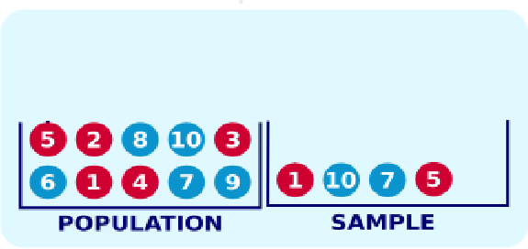
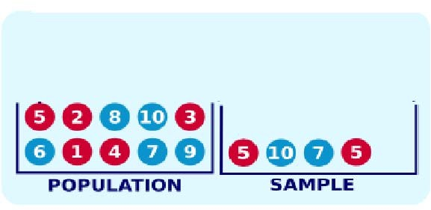
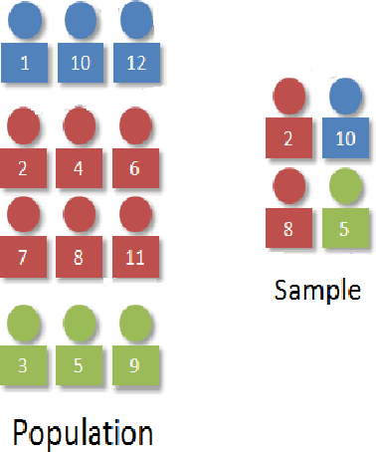
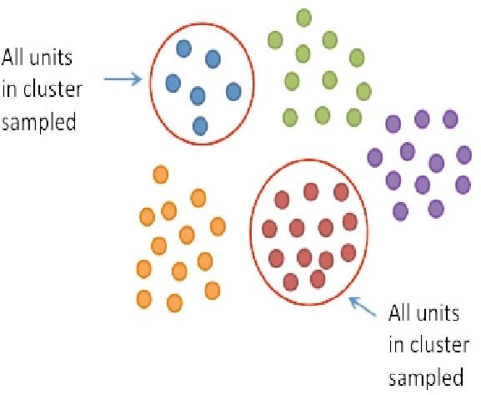
Sampling Methods
Simple random sample without replacement
Simple random sample with replacement
Cluster sample
Stratified sample

Slide 32
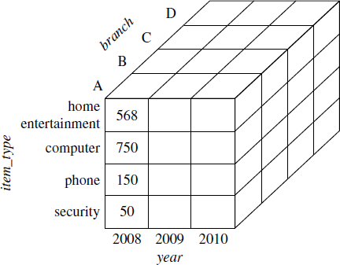
Non‐Parametric Methods
Data Cube Aggregation
– Data cubes store multidimensional aggregated information

Slide 33
Data Cube
A data cube allows data to be modeled and viewed in multiple dimensions
Dimensions: perspectives or entities with respect to which an organization wants to keep records
Sales DW: records store’s sales w.r.t. dimensions time, item, branch, and location
Facts: numeric measures, quantities by which relationships are analyzed between dimensions
– Sales in $, units sold
n‐dimensional

Slide 34
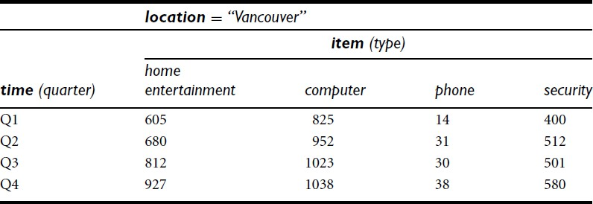
2‐D Data Cube
The sales are from branches located in the city of Vancouver. The measure displayed is
dollars sold (in thousands)

Slide 35
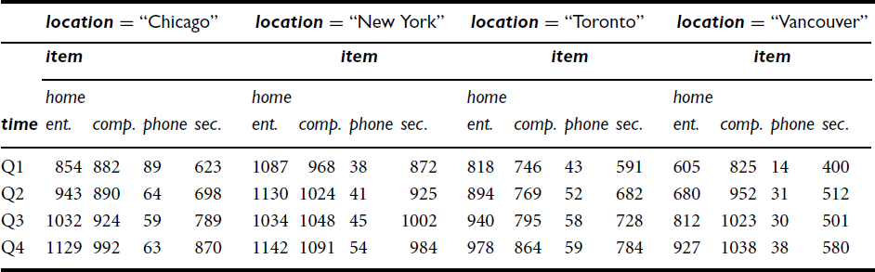
3‐D Data Cube

Slide 36
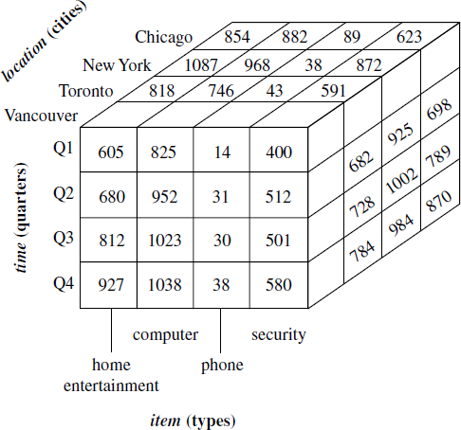
3‐D Data Cube

Slide 37
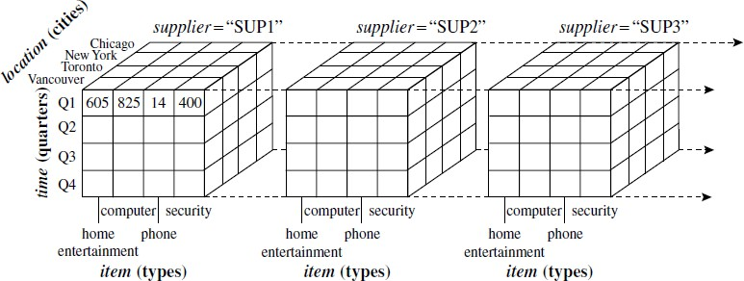
4‐D Data Cube
display any n‐dimensional data as a series of (n‐1)‐ dimensional “cubes”

Slide 38
Lattice
Data cubes often referred as Cuboids in DW literature
Given a set of dimensions, a cuboid can be generated for each of the possible subsets of the given dimensions
Lattice of cuboids ‐ each showing the data at a different level of summarization, or group‐by
Base cuboid ‐ lowest level of summarization
Apex cuboid ‐ highest level of summarization

Slide 39
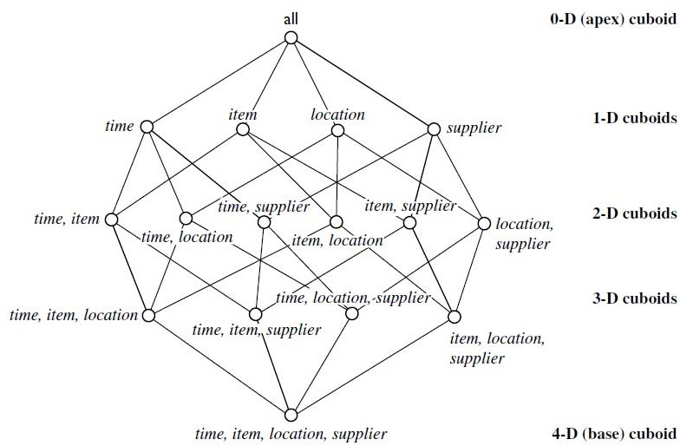
A Lattice of Cuboids

Slide 40
Data Reduction 3: Data Compression
String compression
Typically lossless
Audio/video compression
Typically lossy compression
Dimensionality and numerosity reduction may also be considered as forms of data compression

Slide 41
Data Transformation
A function that maps the entire set of values of a given attribute to a new set of replacement values
Objective – make mining process more efficient, and patterns found easier to understand
Methods
Smoothing: Remove noise from data
Attribute/feature construction
New attributes constructed from the given ones
Aggregation: Summarization, data cube construction
Normalization: Scaled to fall within a smaller, specified range
min‐max normalization
z‐score normalization
normalization by decimal scaling
Discretization: Concept hierarchy climbing

Slide 42
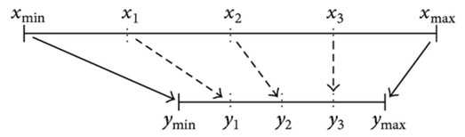

Normalization
Attempt to give all attributes an equal weight
Avoid dependence on the choice of measurement units
Min‐max normalization: [new_min_{A}, new_max_{A}]
Example. Suppose the minimum and maximum values for the attribute income are
$12,000 and $98,000, respectively. We would like to map income to the range [0.0, 1.0]. By min‐max normalization, a value of $73,600 for income is
transformed to
preserves the relationships among the original data values
will encounter an “out‐of‐bounds” error if a future input case for normalization falls outside of the original data range for A

Slide 43
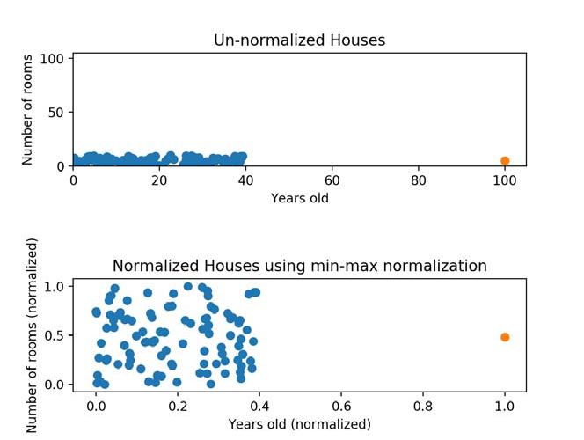
Normalization
Min‐max normalization
Guarantees all features will have the exact same scale
Does not handle outliers well
https://www.codecademy.com/articles/normalization

Slide 44



Normalization
Z‐score normalization ( :mean, :standard deviation):
Suppose that the mean and standard deviation of the values for the attribute income are $54,000 and $16,000, respectively. With z‐score normalization, a value of $73,600 for income is transformed to
A variation of this z‐score normalization replaces the standard deviation by the
mean absolute deviation of the attribute
Mean absolute deviation is more robust to outliers than the standard deviation
Z‐score normalization: useful when (1) the actual minimum and maximum of attribute are unknown, or (2) when there are outliers that dominate the min‐ max normalization

Slide 45
Normalization
Z‐score normalization
Z‐score is calculated using population mean and standard deviation
Measures how many standard deviations below or above the population mean a raw score is
Z‐scores range from ‐3 standard deviations (far left of the normal distribution curve) up to +3 standard deviations (far right of the normal distribution curve)
If a value is exactly equal to the mean of all the values, it will be normalized to 0
If it is below the mean, it will be a negative number, and if it is above the mean it will be a positive number
Size of those negative and positive numbers is determined by the standard deviation of the original feature
Z‐scores are a way to compare results to a “normal” population
Standard deviation of the z‐scores is always 1, mean of the z‐scores is always 0
Handles outliers, but does not produce normalized data with the exact same scale

Slide 46

Normalization
Normalization by decimal scaling
normalizes by moving the decimal point of values of attribute
number of decimal points moved depends on the maximum absolute value of the attribute
Example. Suppose that the recorded values of A range from –986 to 917. The maximum absolute value of A is 986. To normalize by decimal scaling, we therefore divide each value by 1000 (i.e., j = 3) so that –986 normalizes to –0.986 and 917 to 0.917
normalization can change the original data quite a bit, especially when using z‐score normalization or decimal scaling
necessary to save the normalization parameters (e.g., the mean and standard deviation if using z‐score normalization) so that future data can be normalized in a uniform manner

Slide 47
Discretization
Divide the range of a continuous attribute into intervals
Replace raw values of a numeric attribute (e.g., age) by interval labels (e.g., 0–10, 11–20, etc.) or conceptual labels (e.g., youth, adult, senior)
Reduce data size
Patterns easier to understand
Supervised (uses class information) vs. unsupervised
Split (top‐down) vs. merge (bottom‐up)
Discretization can be performed recursively on an attribute

Slide 48
Data Discretization Methods
Binning ‐ Top‐down split, unsupervised
Histogram analysis ‐ Top‐down split, unsupervised
Clustering ‐ top‐down split or bottom‐up merge, unsupervised, considers distribution of the attribute, produce high‐quality discretization
Decision‐tree analysis ‐ top‐down split, supervised, uses entropy to determine split point
Correlation (e.g., χ2) ‐ bottom‐up merge, supervised, find the best neighboring intervals (those having similar distributions of classes, i.e., low χ² values) to merge
All the methods are applied recursively, until a predefined stopping condition

Slide 49
Concept Hierarchy Generation
Concept hierarchy organizes concepts (i.e., attribute values) hierarchically and is usually associated with each dimension in a DW
Location: street < city < state < country
Facilitates drilling and rolling to view data in multiple granularity
Recursively reduce the data by collecting and replacing low level concepts (such as numeric values for age) by higher level concepts (such as youth, adult, or senior)
Can be automated for both numeric and nominal data

Slide 50
Automatic Concept Hierarchy Generation
Some hierarchies can be automatically generated based on the analysis of the number of distinct values per attribute in the data set
The attribute with the most distinct values is placed at the lowest level of the hierarchy
Exceptions, e.g., weekday, month, quarter, year
country
15 distinct values
province_or_ state
365 distinct values
city
3567 distinct values
street
674,339 distinct values

Slide 51
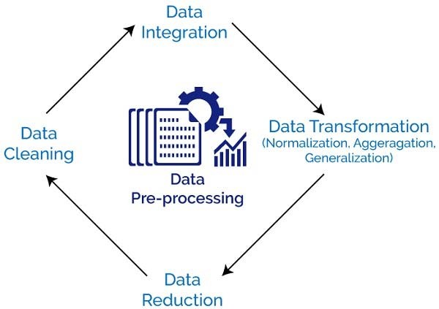
Summary
Data quality: accuracy, completeness, consistency, timeliness, believability, interpretability
Data cleaning: e.g. missing/noisy values, outliers
Data integration from multiple sources:
Entity identification problem; Remove redundancies; Detect inconsistencies
Data reduction
Dimensionality reduction; Numerosity reduction; Data compression
Data transformation and data discretization
Normalization; Concept hierarchy generation

